Slide 1

Data Structures
Lecture 1: Introduction

Slide 2

About the Instructor
Dr. M. Amin Kuhail
PhD in Computer Science
Research Interests: Smart City, Software Engineering, Usability, End-user Development.
Tel: 816-235-2356
E-mail: kuhailm@umkc.edu
Office: 450N FH
Office Hours: TuTh 2:00 PM – 3:00 PM or by appointment
Please send an e-mail before you come to the office as I’m not always there at those times.

Slide 3
Definitions
What are data structures?
A data structures is the arrangement of data in a computer’s memory (e.g. arrays are data structures)
What is an algorithm?
An algorithm is a step-by-step procedure for calculating or processing the data in the structures (e.g. ordering, searching, analyzing, etc. )
Notes:
a data structure is a particular way of storing and organizing data in a computer so that it can be usedefficiently
Different kinds of data structures are suited to different kinds of applications, and some are highly specialized to specific tasks. For example, B-trees are particularly well-suited for implementation of databases, while compiler implementations usually use hash tablesto look up identifiers.

Slide 4
Problems To Solve With Data Structures
Real-world data storage
Programmer’s tools
Modelling

Slide 5

Real-World Data Storage
Data that describes entities external to the computer.
- The record of a personnel.
- Financial transaction record
Key points to consider: quick insertion, deletion of items, fast searching, sorting.

Slide 6
Programmer’s Tools
Tools to facilitate programmer operations (e.g. compiler operations)

Slide 7
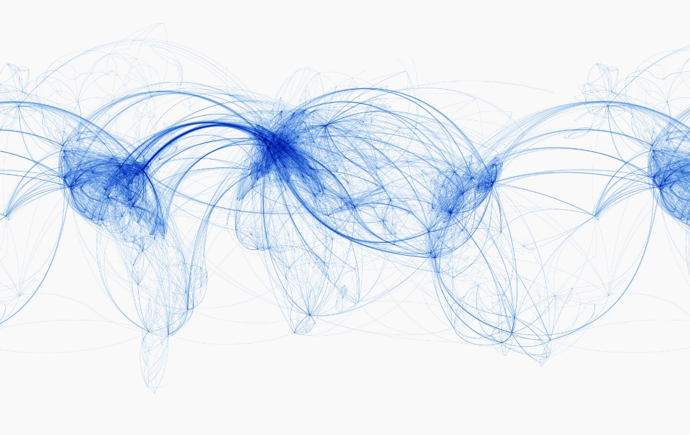


Real-World Modelling
Data Structures that model real-world situations.
- Graphs can represent airline routes between cities.

Slide 8
Overview of Key Data Structures
Data Structure | Advantages | Disadvantages
Vectors | Quick access of an indexed item | Slow access otherwise
Stacks | Last-in, first-out access | Slow access otherwise
Queues | First-in, first-out access | Slow access otherwise
Linked lists | Quick insertion, quick deletion | Slow search
Trees | Quick search, insertion, deletion | Complex
Hash tables | Fast access if key is known. Fast insertion | Slow deletion, slow search if key is not known, inefficient memory usage
Graphs | Models real-world situations | Some algorithms are slow and complex

Slide 9
Overview of Algorithms
Insert a new data item
Search for a specified item
Delete a specified item
Sort items

Slide 10
Course Contents
Efficiency of Algorithms (Big O)
Vectors, Lists
Stack Applications
Queue Applications
Parallel Programming with OpenMP
Sorting Algorithms
Binary Trees
Binary Search Trees
Heaps
Hash tables
Self-balancing Binary Search Trees

Slide 11

Textbook
Optional: | Objects, Abstraction, Data Structures and Design Using C++ by Elliot B. Koffman and Paul A.T. Wolfgang, John Wiley & Sons, 2006. ISBN 978-0-471-46755-7
Extra: | Data Structures and Algorithms in Java by Robert Lafor, Sams Publishing; 2 edition (November 16, 2002)

Slide 12

Lectures
It is a good idea to read in advance the topic I teach.
The slides mostly correspond to the textbook. I will try to upload them ahead of time.
Some of the slides I use are animated in order to reinforce the concepts.
Attendance is mandatory.
Ask questions on the way, I will always try to answer them if I have the time. Otherwise, we can have a side short discussion after the lecture or in the office.

Slide 13

Tasks
I will give in-class tasks to reinforce the concepts.
We will discuss the solutions to these tasks together in the class.

Slide 14
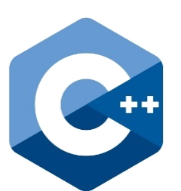
Code Demonstration
I will demonstrate the source code in some examples with Visual Studio 2013.
I will post the code on Blackboard.
It is imperative that you run the code yourself at home, trace it step by step, and make sure that you understand it.
Download the latest Visual Studio version from Microsoft DreamSpark 2013/2015. It is free for students. Consult with me if you have trouble running the source code.

Slide 15
Not in the Book
Not in the book
Many examples aren’t in the book. I will mark them for your benefit.

Slide 16


Examples and Case Studies
Airline Reservation System
Phone Book
Banking System
Compression Trees

Slide 17

Assignments
Reinforcing the concepts
Important for understanding the concept.
You can work in pairs or individually.
You can always contact me or the TA about assignments.

Slide 18

Quizzes
There will be quizzes every week.
Pop quizzes.
Quizzes will be given at the beginning or end of the lecture.
Quizzes account for 10% extra credit. That means you can earn up to 10 extra points if you score full marks in all your quizzes.

Slide 19

Projects (1)
There will be two projects in total.
Involve problem solving and analytical thinking.
Involve making UML diagrams of your solution.
Grades will not be based on correctness only, but also quality and style.
All projects are team-based. However, you can work on your own, but working in a team is highly encouraged. A project should have 3 members max. I will send you a link to a spreadsheet for you to enter the teams. Those who don’t enter their teams will be put in teams randomly.

Slide 20
Projects (2)
You can submit your project code in C++, C#, or Java.
I will post project guidelines on Blackboard.
One consultation per project: It is highly recommended that you consult with me your ideas and solutions before you make a submission. You get one consultation per project.
You can book an appointment with me regarding a consultation. However, to expedite the meeting, send me an e-mail about your work and the issues you want to discuss.
There is one point extra credit within the scope of each project for students who use GitHub.

Slide 21
Late Policy
If you submit your assignments or projects late, you will lose 5% of the grade for each late day.
You cannot submit a project or an assignment 7 days after the deadline of the project or assignment submission (unless there are extenuating circumstances discussed with the instructor)
You have 10 days to discuss a grade with me/TA.
I grade exams. The TA grades everything else.

Slide 22
About the Course
The course is very demanding. Don’t expect to pass the course by simply attending the course. You need to study, work hard on the tasks, assignments, and projects in order to pass it.
Always ask for help. The easiest way to reach me is by sending an e-mail. Tell me what you are struggling with, and let’s have a meeting about it.

Slide 23

Grading
Projects: | 30 points (2 projects: 1st 15 points, 2nd project: 15 points)
Assignments: | 20 points (the worst one will be dropped)
Midterm Exam: | 25 points
Final Exam: | 25 points
Quizzes: | Up to 5 extra points

Slide 24
Data Structures
Pointers vs. References
Reference: https://www3.ntu.edu.sg/home/ehchua/programming/cpp/cp4_PointerReference.html

Slide 25
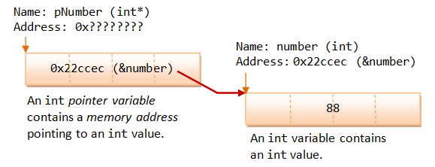

Pointers (1)
A variable is a named location that contains data.
A variable has a type, value, and an address.
A pointer variable (or pointer in short) is basically the same as the other variables, which can store a piece of data. Unlike normal variable which stores a value (such as an int, a double, a char), a pointer stores a memory address.
Reference: https://www3.ntu.edu.sg/home/ehchua/programming/cpp/cp4_PointerReference.html

Slide 26
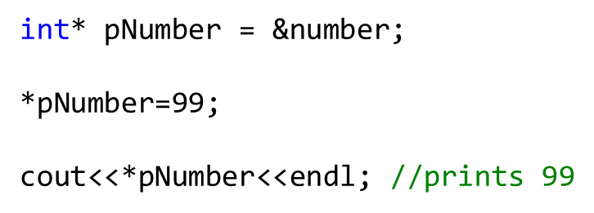

Pointers (2)
To read the value the pointer is pointing to, use the derferenceing operator (*)
The type of the pointer and the variable it points to must match
Reference: https://www3.ntu.edu.sg/home/ehchua/programming/cpp/cp4_PointerReference.html

Slide 27
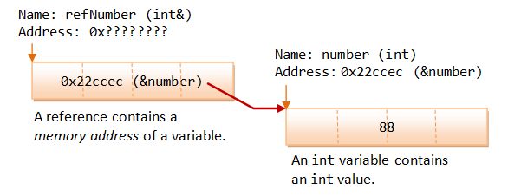




References
A reference works as a pointer. A reference is declared as an alias of a variable. It stores the address of the variable, as illustrated:
Reference: https://www3.ntu.edu.sg/home/ehchua/programming/cpp/cp4_PointerReference.html

Slide 28
References vs Pointers
A reference is a name constant for an address. You need to initialize the reference during declaration.
Reference: https://www3.ntu.edu.sg/home/ehchua/programming/cpp/cp4_PointerReference.html

